Slide 1
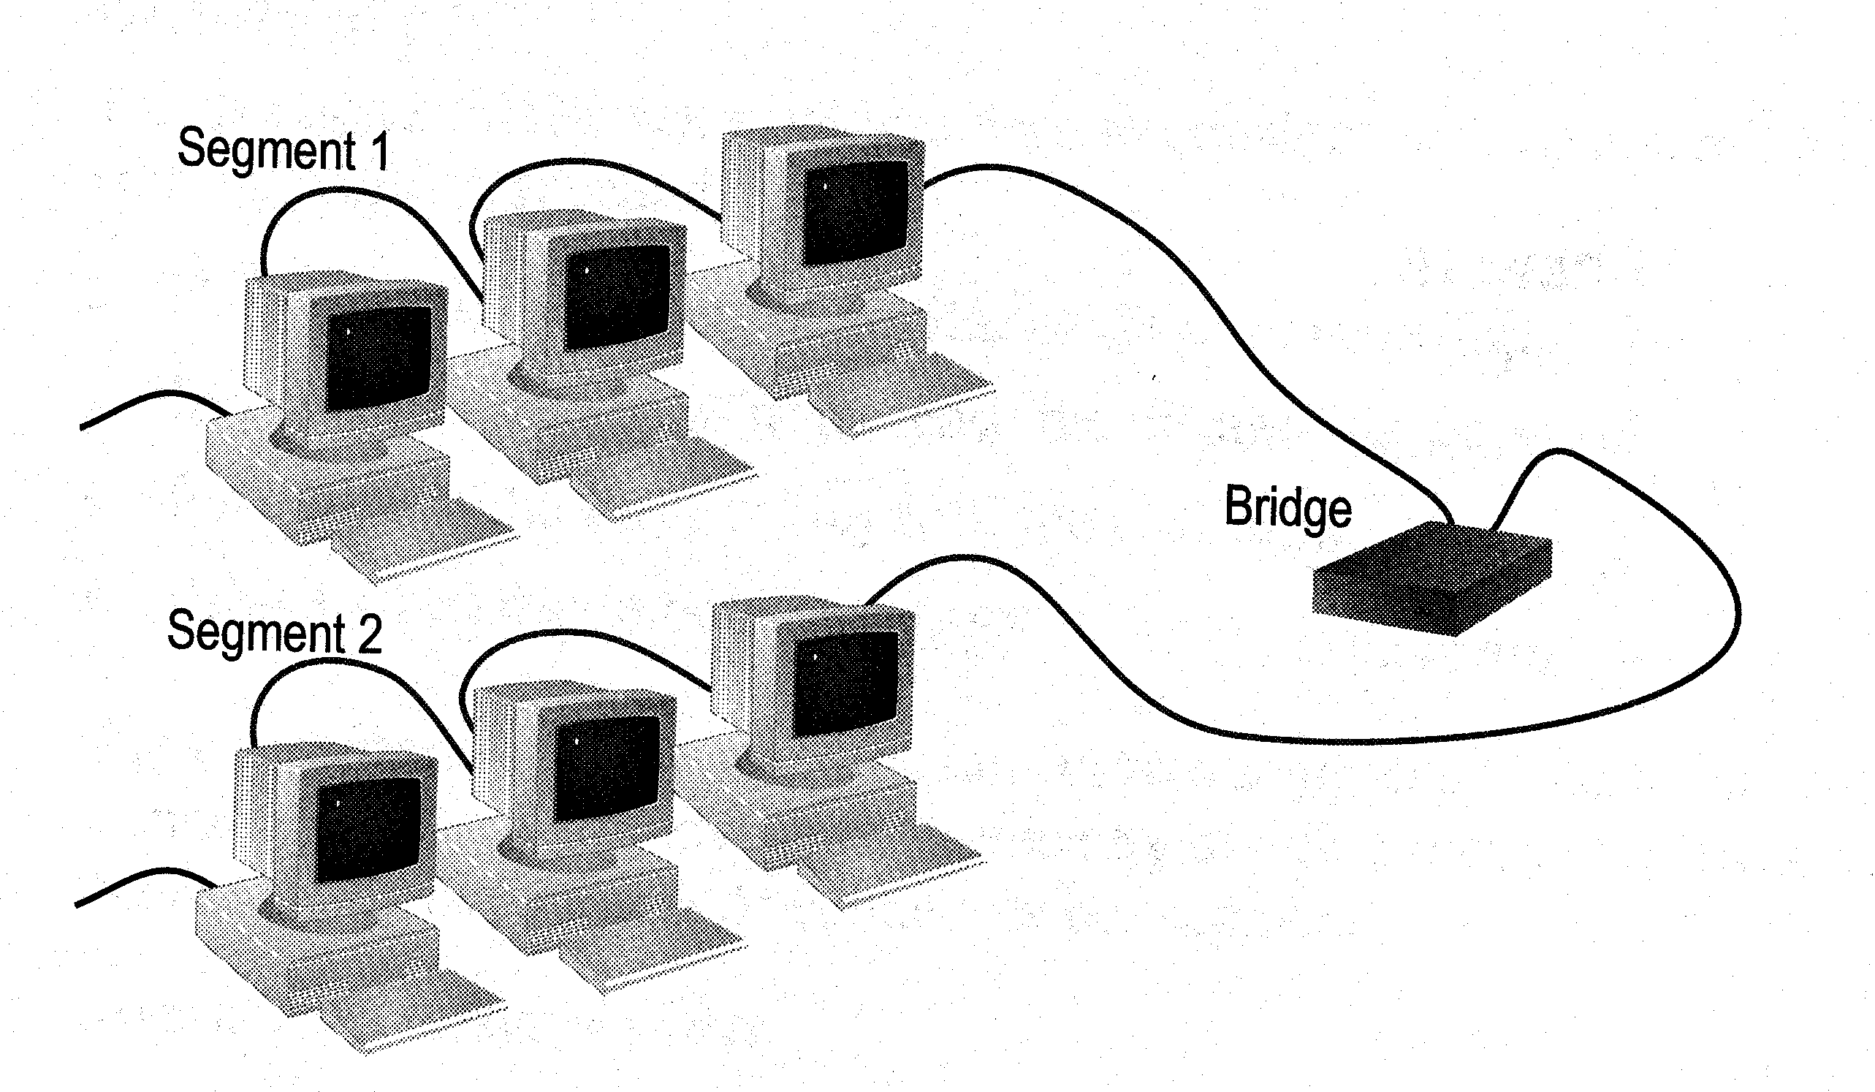

Network Devices

Slide 2
Network Devices
Functions of network devices
Separating (connecting) networks or expanding network
  e.g. repeaters, hubs, bridges, routers, brouters, switches, gateways
Remote access
  e.g. 56K Modems and ADSL modems

Slide 3
Network Devices
A. Expanding Network
Networks cannot be made larger by simply adding new computers and more cables
  Less efficient !!
Can install components to
  segment (divide) large LAN to form smaller LANs
  connect LANs
Required components
  Repeaters, bridges, routers, brouters, switches or gateways

Slide 4
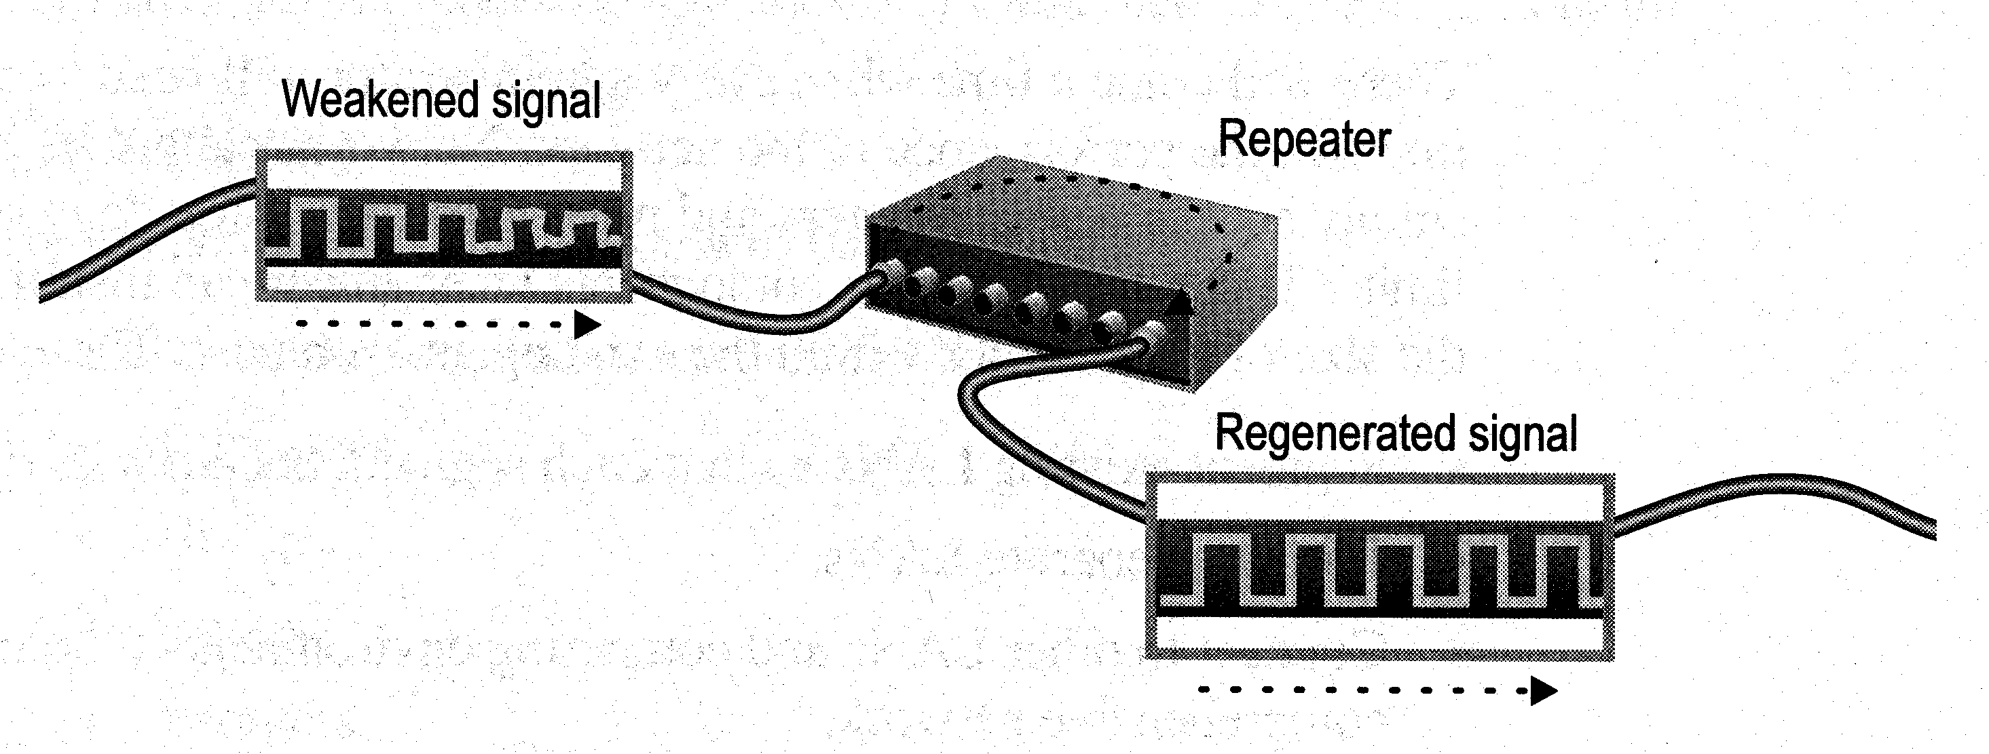
Network Devices
a. Repeaters and Hubs
Repeaters or hubs work at the OSI physical layer to regenerate the network’s signal and resend them to other segments
Primitive hub can be viewed as a multiport repeater
  It regenerates data and broadcasts them to all ports
Hub

Slide 5
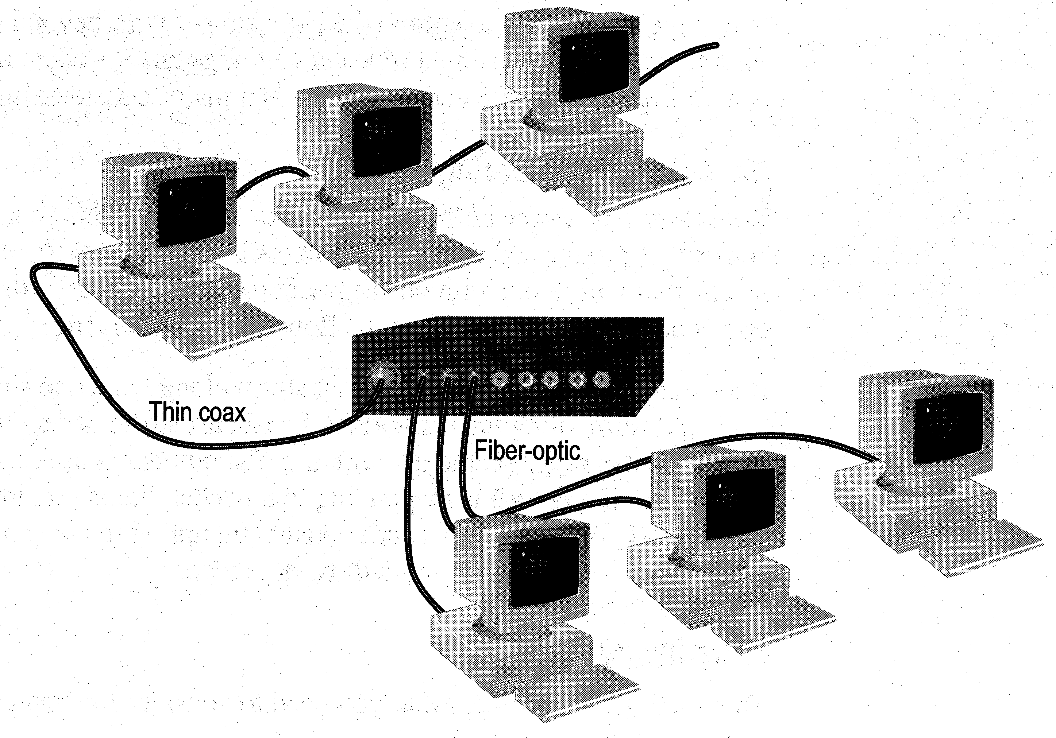
Network Devices
Limitations and Features
Cannot link unlike segments
Cannot join segments with different access methods (e.g. CSMA/CD and token passing)
Do not isolate and filter packets
Can connect different types of media
The most economic way of expanding networks

Slide 6
Network Devices
b. Bridges
Has one input and one output
Used to isolate network traffic and computers
Has the intelligent to examine incoming packet source and destination addresses
But cannot interpret higher-level information
Hence cannot filter packet according to its protocol

Slide 7
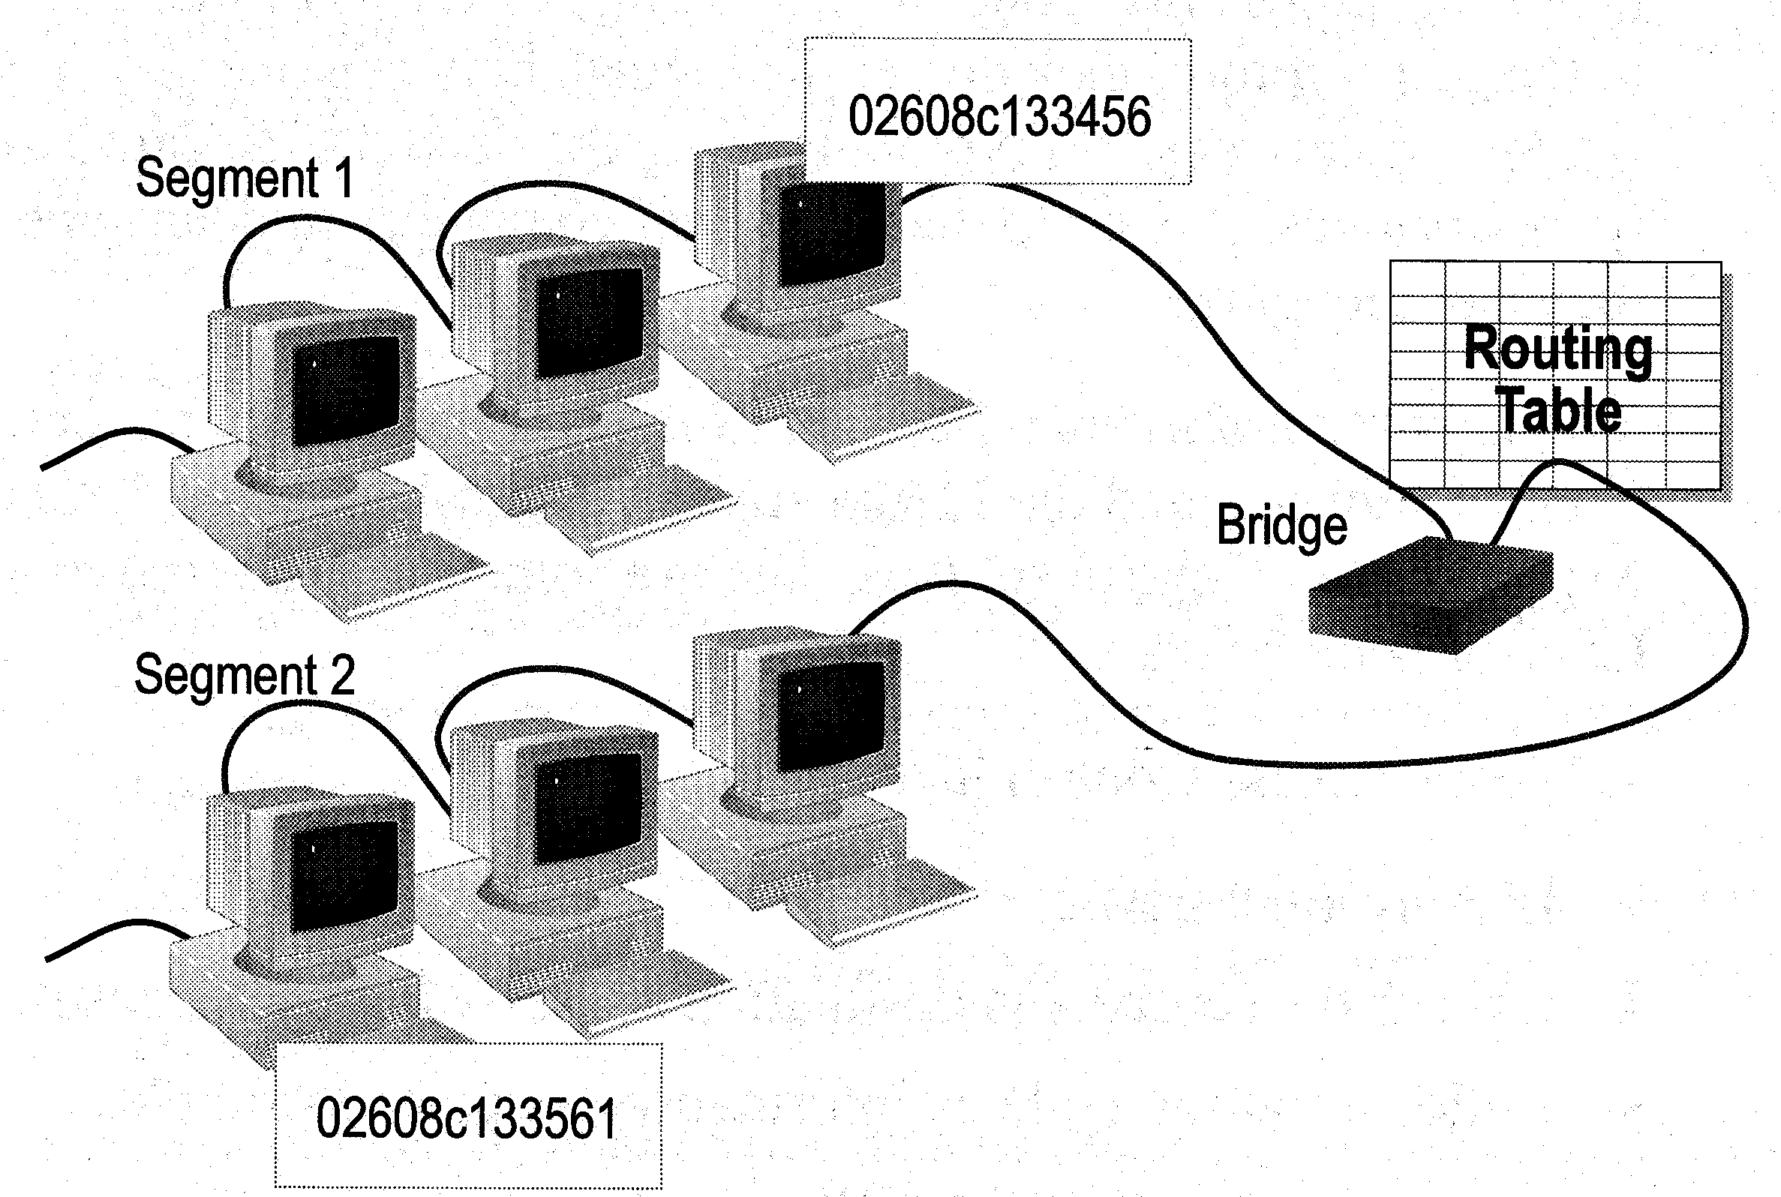
Network Devices
How Bridges Work
Bridges work at the Media Access Control Sub-layer of the OSI model
  Routing table is built to record the segment no. of address
  If destination address is in the same segment as the source address, stop transmit
  Otherwise, forward to the other segment

Slide 8
Network Devices
Creating a Switching Table
Based on the addresses of the sending computers
New addresses are added if they are not in the table
Add02
S 02 D 01
Switching Table
Seg 1 Seg 2
Add01
01
Stop
02
Add03
S 01 D 02

Slide 9
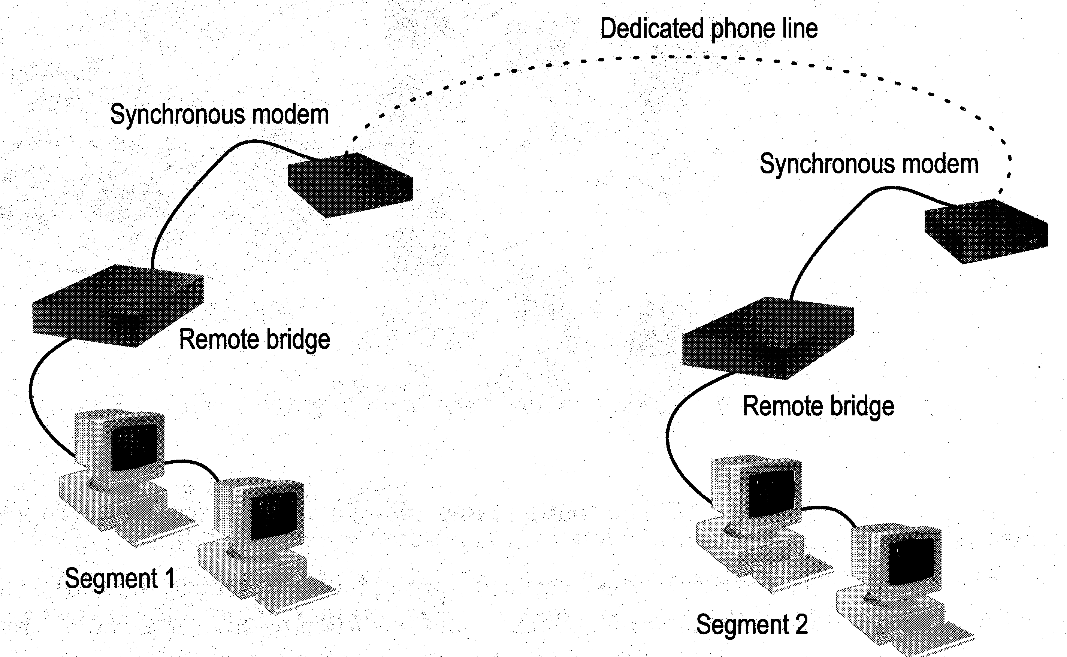
Network Devices
Remote Bridges
Bridges are often used in large networks that have widely dispersed segments
Remote bridges can be used to connect remote segments via data-grade telephone line

Slide 10
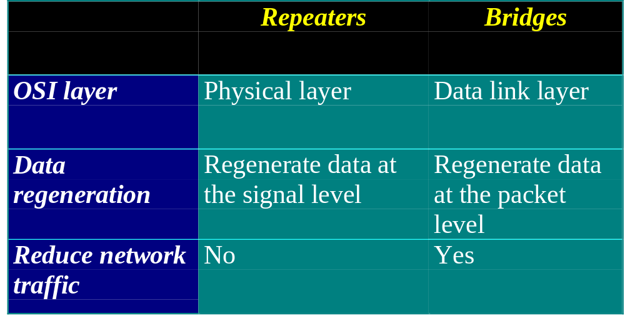
Network Devices
Differences Between Bridges and Repeaters

Slide 11
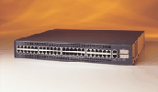
Network Devices
c. Switches
Switches operate at the Data Link layer (layer 2) of the OSI model
Can interpret address information
Switches resemble bridges and can be considered as multiport bridges
By having multiports, can better use limited bandwidth and prove more cost-effective than bridge
Cisco Catalyst 2900 switch

Slide 12
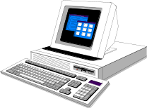
Network Devices
Switches divide a network into several isolated channels
Packets sending from 1 channel will not go to another if not specify
Each channel has its own capacity and need not be shared with other channels
Hub
3.3Mbps
10Mbps
Switch
3.3Mbps
3.3Mbps
10Mbps
10Mbps
10Mbps

Slide 13
Network Devices
Advantages of Switches
Switches divide a network into several isolated channels (or collision domains)
  Reduce the possibility of collision
    Collision only occurs when two devices try to get access to one channel
    Can be solved by buffering one of them for later access
  Each channel has its own network capacity
    Suitable for real-time applications, e.g. video conferencing
  Since isolated, hence secure
    Data will only go to the destination, but not others

Slide 14
Network Devices
Limitations of Switches
Although contains buffers to accommodate bursts of traffic, can become overwhelmed by heavy traffic
  Device cannot detect collision when buffer full
    CSMA/CD scheme will not work since the data channels are isolated, not the case as in Ethernet
  Some higher level protocols do not detect error
    E.g. UDP
  Those data packets are continuously pumped to the switch and introduce more problems

Slide 15
Network Devices
Method of Switching - Cut Through Mode
Preamble
Des. Add
Sour. Add
Length
Data
FCS
7
Bytes
1
Byte
2/6
Bytes
2/6
Bytes
2
Bytes
46 - 1500 Bytes
4
Bytes
Read the first 14 bytes of each packet, then transmit
Much faster
Cannot detect corrupt packets
Can propagate the corrupt packets to the network
Best suited to small workgroups

Slide 16
Network Devices
Method of Switching - Store and Forward Mode
Read the whole packet before transmit
Slower than the cut-through mode
More accurate since corrupt packets can be detected using the FCS
More suit to large LAN since they will not propagate error packets
Facilitate data transfer between segments of different speed
DB
100Mbps
10Mbps

Slide 17
Network Devices
Using Switches to Create VLANs
Switches can logically group together some ports to form a virtual local area network (VLAN)
SW1
VLAN1
VLAN2
Hub
SW2
Hub
Switches can be configured to communicate only within the devices in the group
SW3
Hub

Slide 18
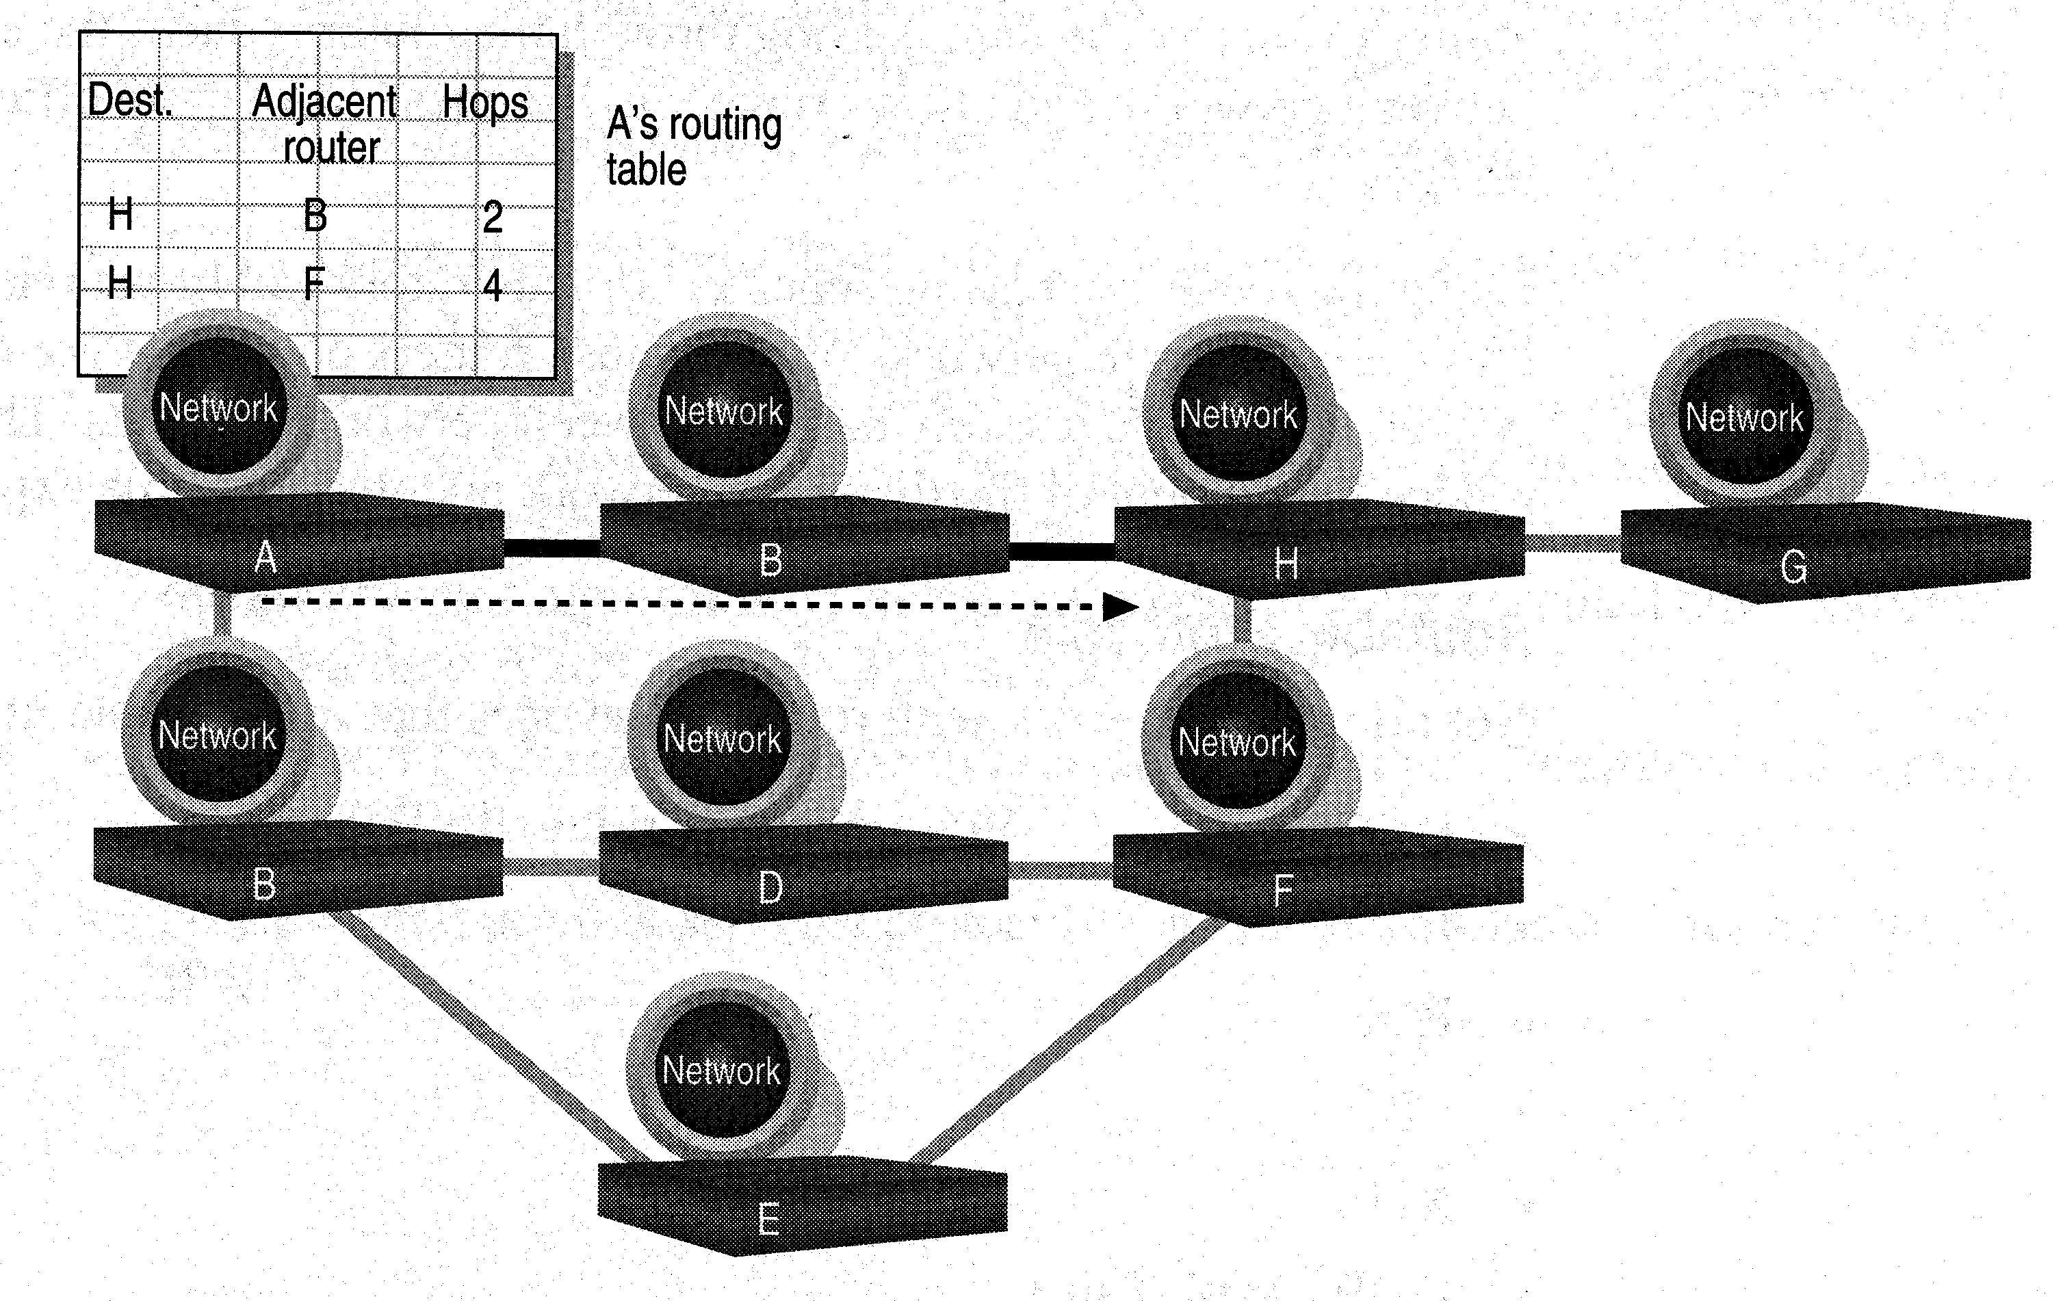
Network Devices
d. Routers
Layer 2 Switches cannot take advantage of multiple paths
Routers work at the OSI layer 3 (network layer)
They use the “logical address” of packets and routing tables to determine the best path for data delivery

Slide 19
Network Devices
How Routers Work
As packets are passed from routers to routers, Data Link layer source and destination addresses are stripped off and then recreated
Enables a router to route a packet from a TCP/IP Ethernet network to a TCP/IP token ring network
Only packets with known network addresses will be passed - hence reduce traffic
Routers can listen to a network and identify its busiest part
Will select the most cost effective path for transmitting packets

Slide 20
Network Devices
How Routing Table is formed
Routing table is formed based on communications between routers using “Routing Protocols”
  Routing Protocols ≠ Routable Protocol
Routing Protocols collect data about current network status and contribute to selection of the best path
Routers communicate within themselves

Slide 21
Network Devices
Routing Protocol Example - RIP for IP Routing
RIP (Routing Information Protocol) ― the oldest one
Use no. of hops between nodes to determine best path
Does not consider the network congestion condition
Broadcast every 30 sec the routing table to neighbouring routers to convey routing information
RIP is limited to interpreting a maximum of 16 hops
Not suitable for large network (e.g. Internet)
Can create excessive network traffic due to broadcasting
May take a long time to reach the far reaches

Slide 22
Network Devices
Routing Protocol Example - OSPF for IP
OSPF - Open Shortest Path First
Make up the limitations of RIP - can coexist with RIP
In general case, best path refers to the shortest path
In case of traffic congestion, can go a longer path
Each router maintains a database of other router’s links
If link failure notice is received, router can rapidly compute an alternate path
Require more memory and CPU power

Slide 23
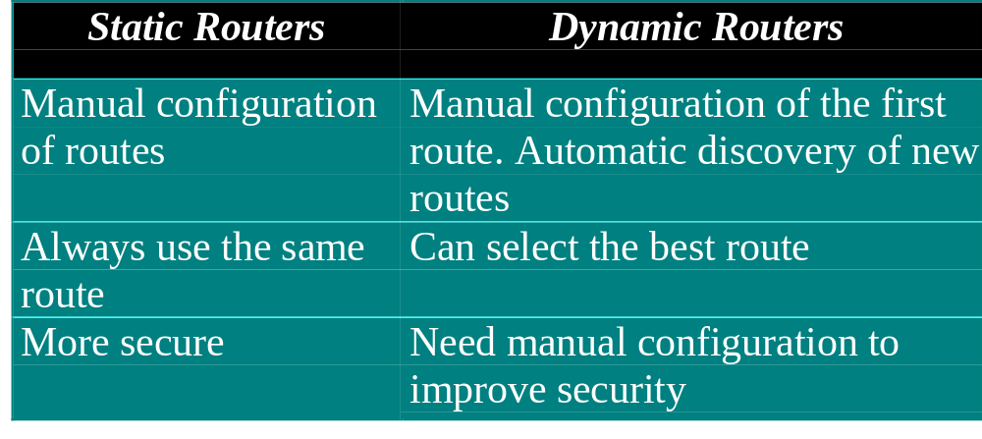
Network Devices
Static and Dynamic Routers

Slide 24
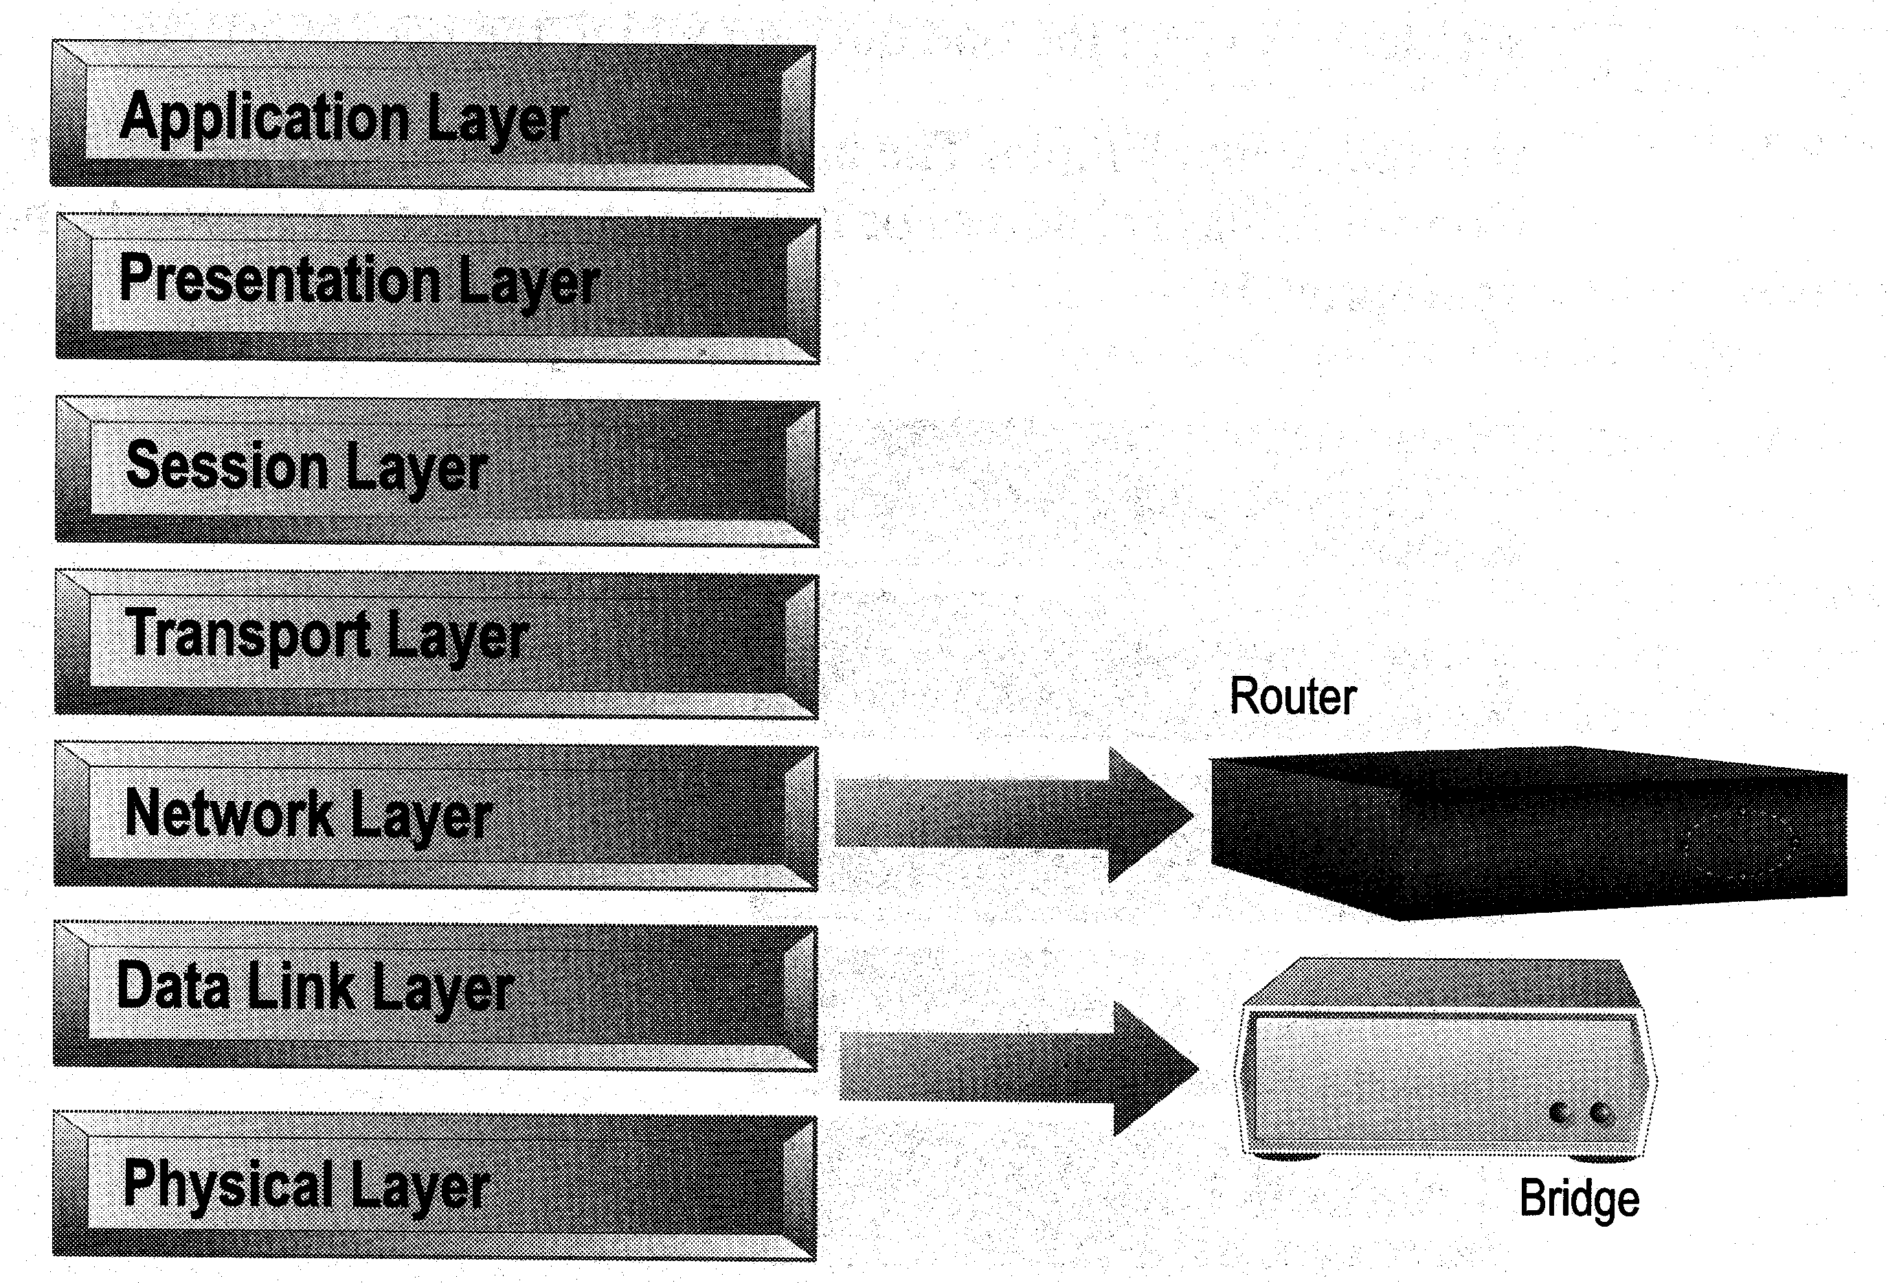
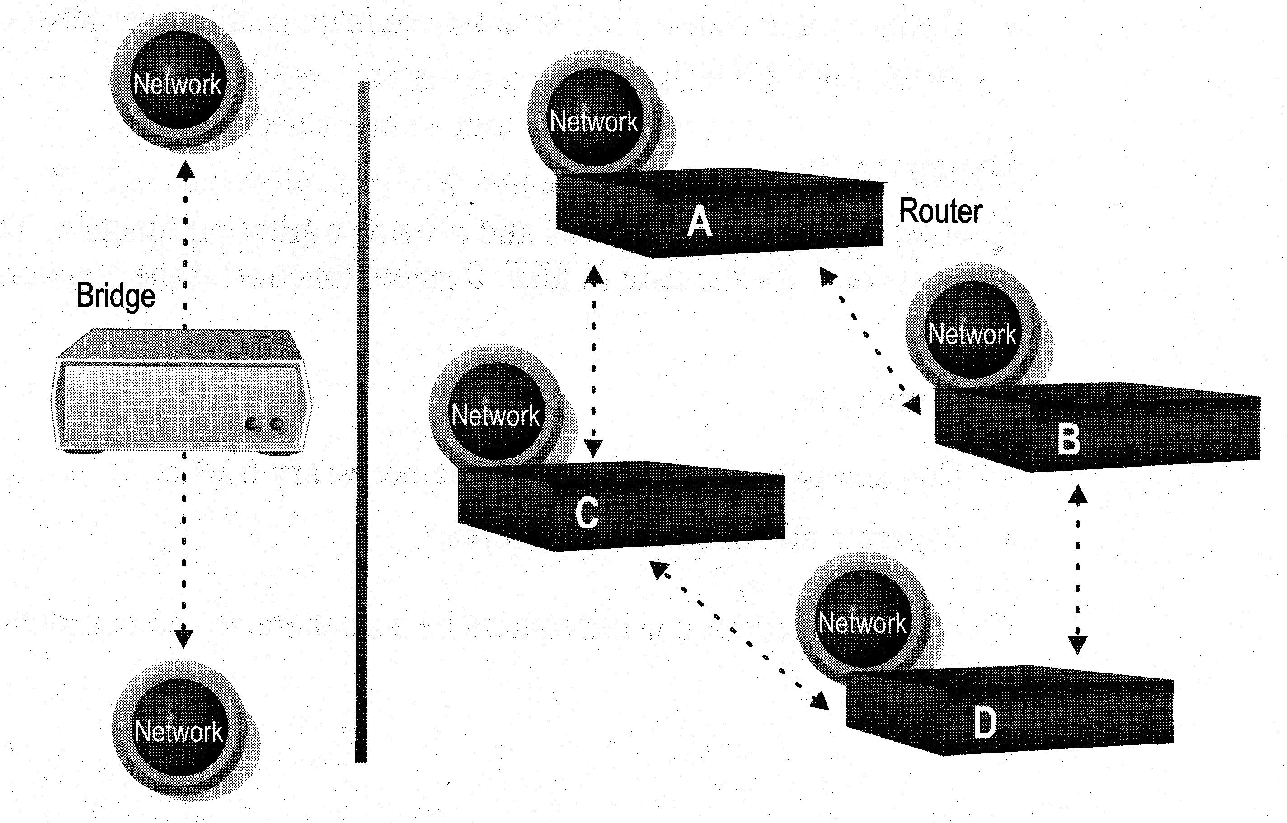
Network Devices
Distinguishing Between Bridges and Routers
Bridges forward everything they don’t recognize
Routers select the best path
Routers are layer 3 devices which recognize network address
Bridges are layer 2 devices which look at the MAC sublayer node address

Slide 25
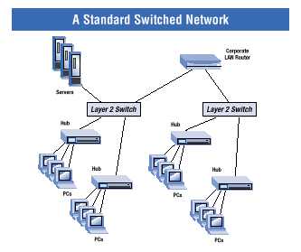
Network Devices
Layer-3 Switches
Layer-3 switches operate in both layer 2 (data link layer) and 3 (network layer)
Can perform both MAC switching and IP routing
A combination of switch and router but much faster and easier to configure than router
Why Layer-3 switches?
Traffic of LAN is no longer local
Speed of LAN is much faster
Need a much faster router, however, very expensive
Excerpt from www.intel.com

Slide 26
Network Devices
Summary
Repeaters are the least expensive way to expand a network, but they are limited to connecting two segments
Bridges function similar to repeaters, but can understand the node addresses
Switches can be considered as multiport bridges, can divide a network into some logical channels
Routers interconnect networks and provide filtering functions. They can determine the best route

Slide 27

Network Devices

